Slide 1
SECURE DATA HIDING IN IMAGES USING STEGANOGRAPHY
CAPSTONE PROJECT
Presented By : Divyesh Chauhan Vijaykumar
Student Name : Divyesh Chauhan Vijaykumar
College Name & Department : SDJ international college,
Computer Science (BCA)

Slide 2
OUTLINE
Problem Statement
Technology used
Wow factor
End users
Result
Conclusion
Git-hub Link
Future scope

Slide 3
Problem Statement
This project enables secure message embedding in images using steganography and encryption. It encrypts messages with a password and embeds them into the image, preserving the image’s appearance. The tool also allows the extraction and decryption of messages with the correct password. It provides a secure method for confidential communication by combining cryptography and steganography techniques

Slide 4
Technology used
Python: Main programming language.
OpenCV: For image processing and manipulation.
Tkinter: For creating the GUI (Graphical User Interface).
Cryptography (Fernet): For encryption and decryption of messages.
Hashlib: To generate cryptographic keys from passwords.
Base64: For encoding the encryption key to a suitable format. System and Hardware Requirements
OS: Windows, macOS, or Linux
Processor: Intel Core i3 or higher
RAM: 4GB (8GB recommended)
Storage: 500MB free space (SSD preferred)
Python: 3.8+

Slide 5
Wow factors
Password-Based Encryption & Decryption using Fernet for enhanced security
Tabbed Interface for easy navigation between encryption and decryption modes
Encrypted Message in Image for stealth communication
Stop Sequence ("1111111111111110") to accurately terminate the message extraction
Customizable Encrypted Image Output** that looks like a regular image file
Error Handling & User Feedback with clear messages and notifications
Cross-Platform Usability for different image formats with OpenCV integration
Integration of Trusted Cryptographic Libraries like Fernet for industry-standard security

Slide 6
End users
The end users for this steganography tool could include:
Cybersecurity Professionals: For testing and securing communication through covert channels.
Privacy Advocates: Individuals who prioritize securing their messages from third parties.
Penetration Testers: Professionals testing the security of systems, including hidden communication channels.
Cryptography Enthusiasts: People interested in exploring encryption and data hiding techniques.
Developers: Those seeking to integrate steganography into applications for secure messaging.
Forensics Experts: Professionals working with digital forensics to uncover hidden information in images.
Journalists or Whistleblowers: Individuals needing secure ways to communicate sensitive information without detection.

Slide 7
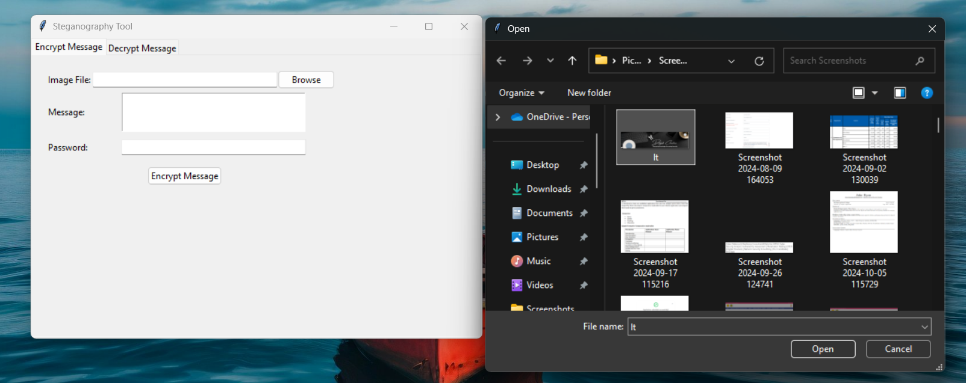
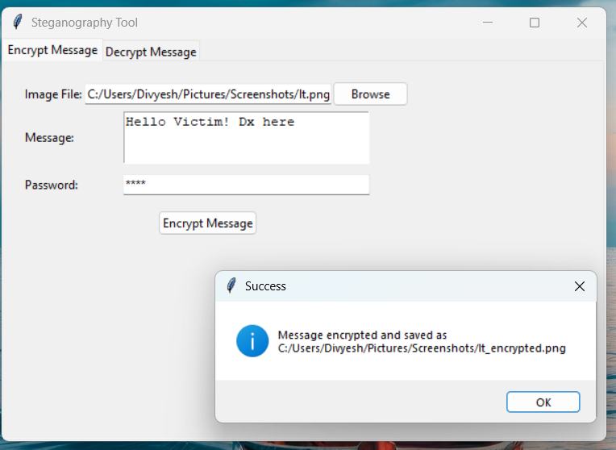
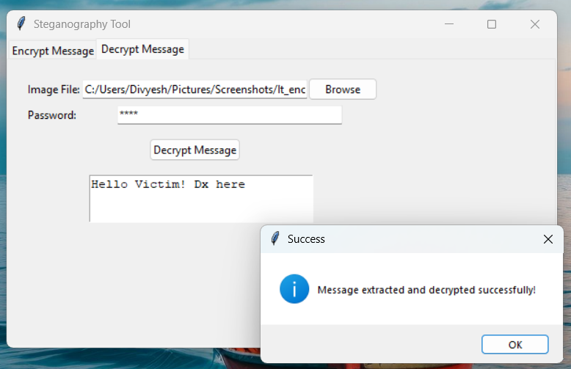
Results
Encrypt: Decrypt:

Slide 8
Conclusion
Effective Security: Embeds encrypted messages within images for secure communication.
User-Friendly Interface: Simple and intuitive GUI for easy encryption and decryption.
Real-World Application: Can be used for secure messaging, with room for improvement.
Growth Potential: Future enhancements like AI detection and cloud integration can increase versatility.
Educational Value: Provides a learning experience in cryptography, image processing, and UI development.

Slide 9
GitHub Link
https://github.com/Dx-27/Aicte_Steganography_tool.git

Slide 10
Future scope(optional)
Here are five future scopes for the project:
Integration with Advanced Encryption Algorithms: Support for algorithms like AES or RSA for stronger security.
Mobile App Development: Extending the tool to mobile platforms like Android and iOS for broader access.
AI-Driven Detection: Implementing AI to automatically detect hidden messages in images, enhancing security.
Cloud Integration: Enabling encrypted message storage and sharing via secure cloud services.
Forensic Analysis Tools: Adding features for forensic investigation to identify and analyze steganography in digital media.
Additionally, we could explore integrating malware detection features, such as using steganography to catch criminals by embedding malicious code in messages for forensic purposes.

Slide 11
THANK YOU

